Slide 1


Experimental signal-noise ratio enhancing of magnetotelluric time series with machine learning
Author: Ing. José R. Campos., Supervisor: Prof. PhD. Alex Marcuello.

Slide 2
Presentation Outline
Introduction | Methodology | Results | Discussion | Conclusions
The problem the solution hypothesis & Objectives Fundamentals | Get the Data Feature Engineering Train the Model Validate the Model Make Predictions | First Simulation Second simulation Real data denoising | What does these results mean and the implications on the subject. | What is the main contribution to the field.

Slide 3
Problem statement line of thinking
Electromagnetic
Methods (EM)
Previous research
Robust methods that hardcode specific denoising.
Machine Learning (ML)
Independent of the type of noise; relationship between the EM components $E=Z ∗B$.
Independent of the type of noise; relationship between the EM components 𝐸=𝑍 ∗𝐵.
Difficulty to obtain quality data in noisy environments
Magnetotelluric (MT)
Characterize and monitor reservoirs → resistivity data
Introduction | Methodology | Results | Discussion | Conclusions
Notes:
Magnetotelluric methods are now being used to characterize and monitor reservoirs with resistivity data, more than ever. However, the main shortcoming of this method is the difficulty to obtain quality data in noisy environments.
The denoising of magnetotelluric data has been widely studied, but each established method has to be applied for a particular type of noise. The main value that this work aims to bring, is to find a method that can be used independently of the type of noise, taking advantage of the known physical relationships between the electromagnetic components.

Slide 4
Hypotheses & Objectives
Hypotheses
Machine Learning provides an ideal solution to find the electromagnetic fields relationship in noisy data.
The relationship between the electric and magnetic fields can be useful for ML, even more if working in the frequency domain.
Stockwell (S) transform can provide a good conversion from time to frequency representation to achieve better results.
Introduction | Methodology | Results | Discussion | Conclusions
Notes:
One of the hypothesis of this work is that Machine Learning provides an ideal solution to find this relationships in noisy data. This relationship is clearer in the frequency domain, therefore, another hypothesis is that the S-transform can be useful to convert the data from a time representation to a frequency representation, to give it as input to the machine learning models for better performance.

Slide 5
Hypotheses & Objectives
Objectives
To established and evaluate a workflow as a new methodology for treating Magnetotelluric noise with Machine Learning.
To use up-to-date open source Python libraries for the noise-to-signal ratio enhancing .
To implement the S-transform as the time-frequency representation (TFR) to achieve better results from the ML mode.
Introduction | Methodology | Results | Discussion | Conclusions
Notes:
Machine Learning provides an ideal solution to find the electromagnetic components relationship in noisy data.
The relationship between the electric and magnetic fields can be useful for ML, even more if working in the frequency domain
S-transform can be useful to convert the data from time representation to frequency representation to achieve favorable results.
Objectives
To established and evaluate a workflow as a new methodology for treating Magnetotelluric noise with Machine Learning
To use up-to-date open source Python libraries for the noise-to-signal ratio enhancing of Magnetotelluric time series.
To implement the S-transform as the time-frequency representation (TFR) of the time series data to be worked with the ML model.

Slide 6
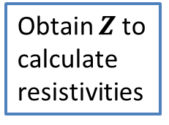
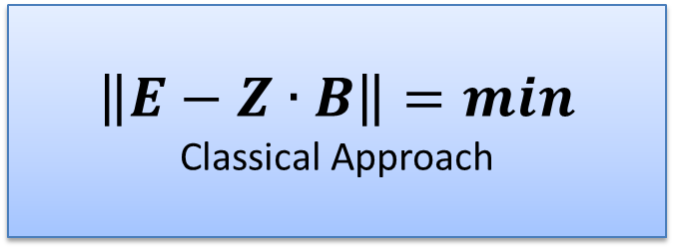
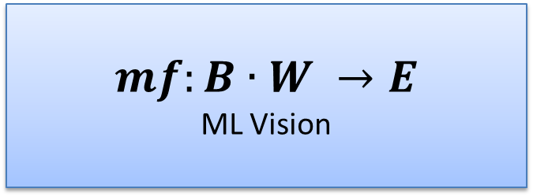
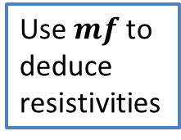
MT Fundamentals
Assume noise type and hardcode the filters
Implement inversion method
Input EM components
$$\left\|E−Z∙B\right\|=min$$
Classical Approach
Obtain $Z$to calculate resistivities
Architect the ML model
Adjust the Hyperparameters
Input EM components
$$mf:B∙W →E$$
ML Vision
Use $mf$to deduce resistivities
For $E \& B$ complex electric and magnetic fields in the frequency Domain
Introduction | Methodology | Results | Discussion | Conclusions
Notes:
In classical MT processing Z is obtained as the answer of an inverse problem, to be latter used to calculate apparent resistivities. For that we must filter the noise before implementing the inversion.
The proposed approach with ML assumes that because there is a correspondence between B and E a mapping function can be found, the main conceptual difference is that with ML we can leave the non coherent noise in the input and the mapping function will reject it.

Slide 7
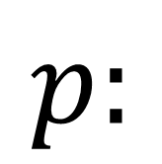
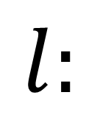
Theoretical Background: Overview
Supervised Machine Learning Models
Machine Learning "Learn" With Data, Without Being Explicitly Programmed
Training Data set
$$l:$$
-
Input (B)
→
Learned
Target (Ep)
Expected
Target (E)
=
Loss
Score
Validation Data set
$$p:$$
Input (B)
→
Predicted
Target (Ep)
-
Expected
Target (E)
=
Accuracy
Score
Introduction | Methodology | Results | Discussion | Conclusions
Notes:
In this work we implemented a Supervised Machine learning model to find the correspondence between the EM fields, known in ML as input and target datasets.
Supervised means that training data with Known or expected features must be available. In this case for each magnetic component we assume that the target is its corresponding electric component. Again, the correspondence between the components is described by a mapping function (MF).
To validate the MF we split the training dataset into training and validation subsets. The main idea is that the Machine learns the MF from the training subset and then we validate that learned function on data that wasn’t use before.

Slide 8
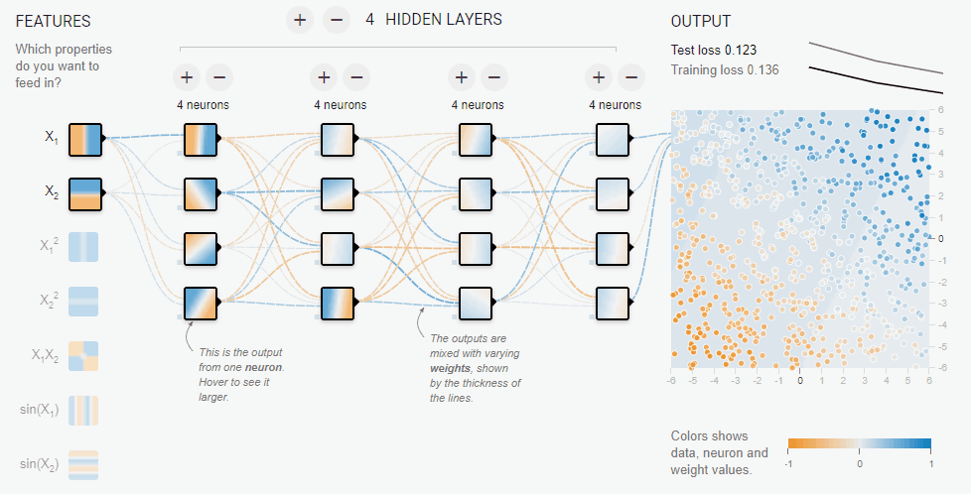
Neural Network
http://playground.tensorflow.org
Introduction | Methodology | Results | Discussion | Conclusions
Notes:
ANN were chosen because they excel in finding non linear relationships between the data.
Artificial Neural Networks are an array of neurons stack by hidden layers, which for each neuron an individual solution to map, in this case, B to E is found. Then the final mapping function is composed mostly by the neurons that found the best transformations (Heavier weights W).

Slide 9
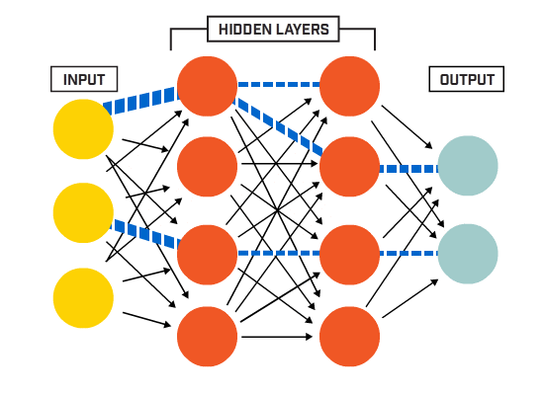
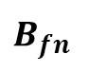
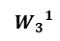
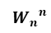
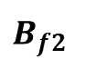
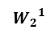
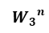
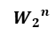
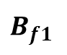
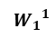
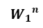
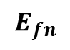
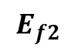
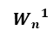
Neural Network per iteration
Magnetic Component
$$B_{f1}$$
$$B_{f2}$$
$$B_{fn}$$
{
{
Weights
$${W_{1}}^{1}$$
$${W_{2}}^{1}$$
$${W_{3}}^{1}$$
$${W_{n}}^{1}$$
Neural network
e.g. n Hidden layers
Weights Update
Gradient * Learning Rate
$${W_{1}}^{n}$$
$${W_{2}}^{n}$$
$${W_{3}}^{n}$$
$${W_{n}}^{n}$$
$$E_{f2}$$
$$E_{fn}$$
Electric
Component
Predicted Electric Component
Optimizer
(Gradient Descend)
Cost
Function
Loss Score
Introduction | Methodology | Results | Discussion | Conclusions
Notes:
This graph shows the ML process for one iteration. As mentioned earlier we provide the neural network with B and E fields.
An specified cost function determines a loss score between the learned/predicted E field and the real or expected E field, then an optimizer (specific version of gradient descend algorithm) produces better weights that are used to update the previous ones in such a way that we tend to end up with a better mapping function.
An important step to improve the model is, as we said, to provide the input in the frequency domain. In ML this term this is known as feature engineering.

Slide 10
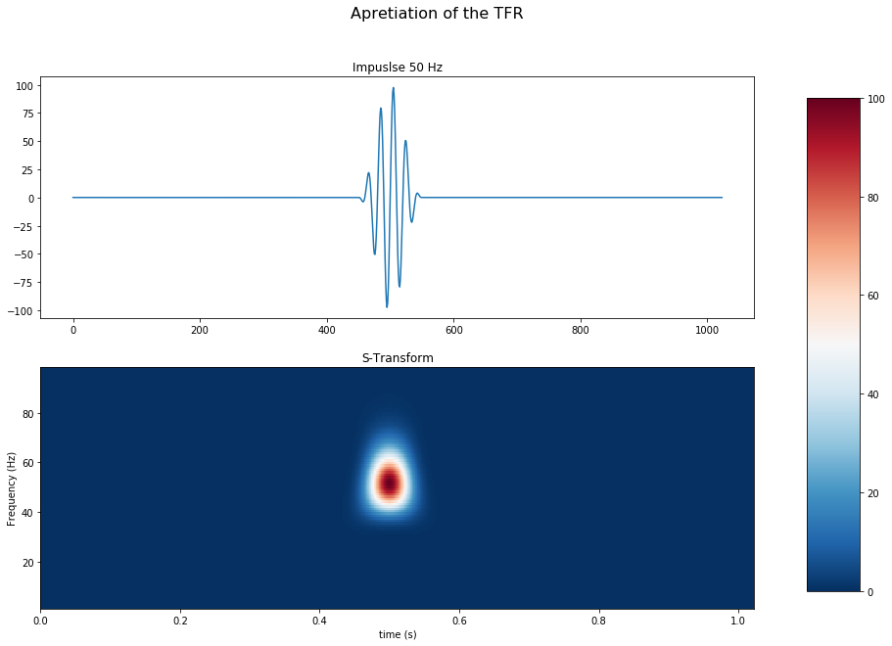
Feature engineering
# Calculate the S-Transform / MNE array function
from mne.time_frequency import tfr_array_stockwell
st_power = tfr_array_stockwell(signal, sfreq, fmin, fmax)
Introduction | Methodology | Results | Discussion | Conclusions
Notes:
For practical purposes the S-Transform can be understand as a particular wavelet transforms that uses a Morlet type wavelet. Basically this wavelets are convoluted at different widths to produce the transform.
In Python a module named MNE provides a already optimized function to calculate the S-Transform, obtaining what is call the TFR of the signal.
In this slide we can appreciate the similitude between an impulse signal with its generated S-transform.

Slide 11
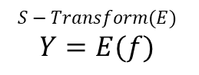
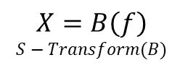
RNN Procedure
$$S−Transform(E)$$
$$Y=E(f)$$
Ef(1,1) |  | Ef(1,3) |  |  |  |  | … | Ef(1,m)
Ef(2,1) |  | Ef(2,3) |  |  |  |  |  | Ef(2,m)
...
Ef(n,1) |  | Ef(n,3) |  |  |  |  |  | Ef(n,m)
RNN
RNN
(LSTM)
RNN
(LSTM)
(…)
RNN
(LSTM)
Bf(1,1) |  | Bf(1,3) |  |  |  |  | … | Bf(1,m)
Bf(2,1) |  | Bf(2,3) |  |  |  |  |  | Bf(2,m)
...
Bf(n,1) |  | Bf(n,3) |  |  |  |  |  | Bf(n,m)
$$X=B\left(f\right)$$
$$S−Transform(B)$$
Frequency
Time
Introduction | Methodology | Results | Discussion | Conclusions
Notes:
Until here we have seen how neural network work, and that TFR of the data will be used as input for the ML model. To bring together these concept Recurrent neural network are used.
The main idea is that RNN process one neural network at each time step. And the mayor benefit is that since our data is sequential it can find patterns in the sequence that bring in more information for the mapping function. RNN take as input the current time step column of the TFR as well as results from previous time steps.
The specific model used in this work is a LSTM network, a particular type of Recurrent Neural Network that excels in finding long term dependencies in the data.

Slide 12
Methodology Summary
Get the Data
Feature Engineering
Train the Model
Make Predictions
Validate the Model
Assuming Parameters
→ Generating the magnetic field
→ Generating the impedance matrix
Generating the electric field
Generating the random noise → Add the noise to the EM fields
Introduction | Methodology | Results | Discussion | Conclusions
Notes:
Generating Electromagnetic time series can be done in Python with the NumPy module. Working with synthetic data is crucial since it provides validation for the model. This procedure is summarized as:
Assuming Parameters
Generating the magnetic field B (120Hz fundamental frequency)
Generating the impedance matrix Z (Assume the resistivity for a homogenous medium)
Generating the electric field from E = ZB
Generating the random noise (Gaussian distribution)
Add the noise to the EM fields

Slide 13
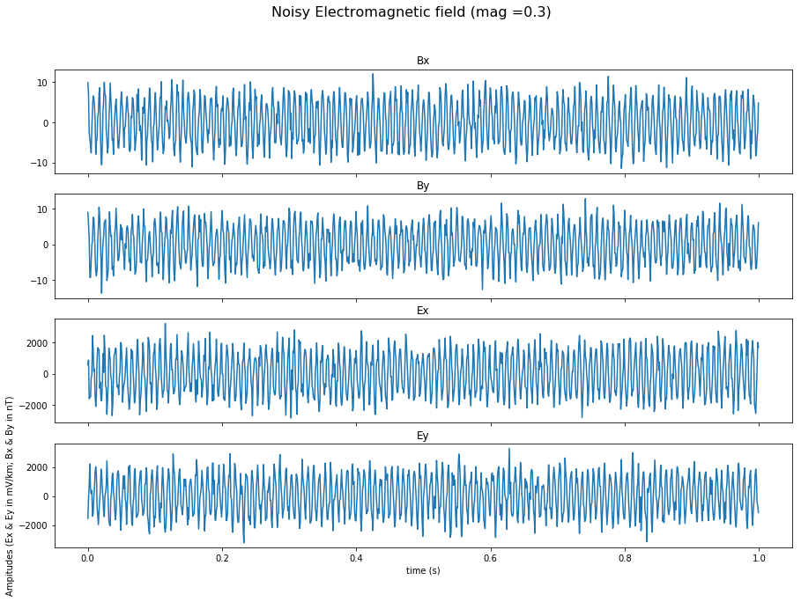
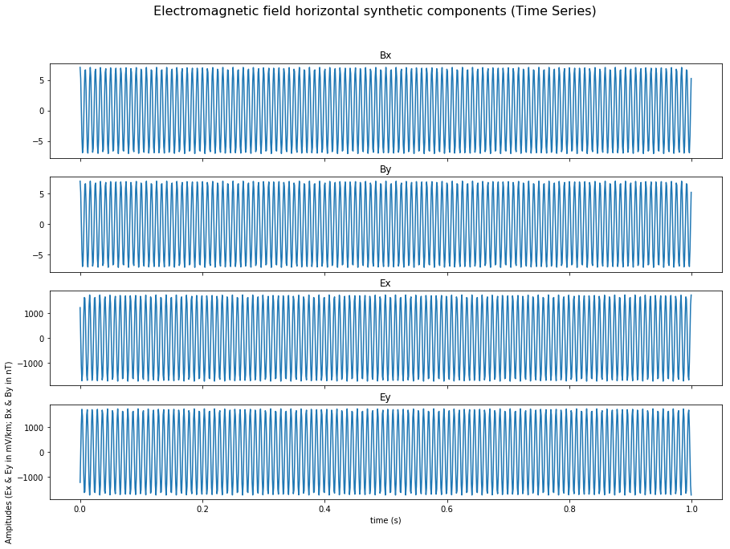
Methodology Summary
Introduction | Methodology | Results | Discussion | Conclusions
Notes:
This slides provides comparison of noise free vs noisy signal.

Slide 14
Methodology Summary
Get the Data
Feature Engineering
Train the Model
Make Predictions
Validate the Model
Add the noise to the EM fields
→ Apply the S-Transform to the signals (field components)
→ Obtain the power matrices
Introduction | Methodology | Results | Discussion | Conclusions
Notes:
Feature engineering the noisy EM fields, again, is applying the S-transform to the field components to obtain the power matrices, for inputting these matrices' columns at every time step into the ML model.

Slide 15
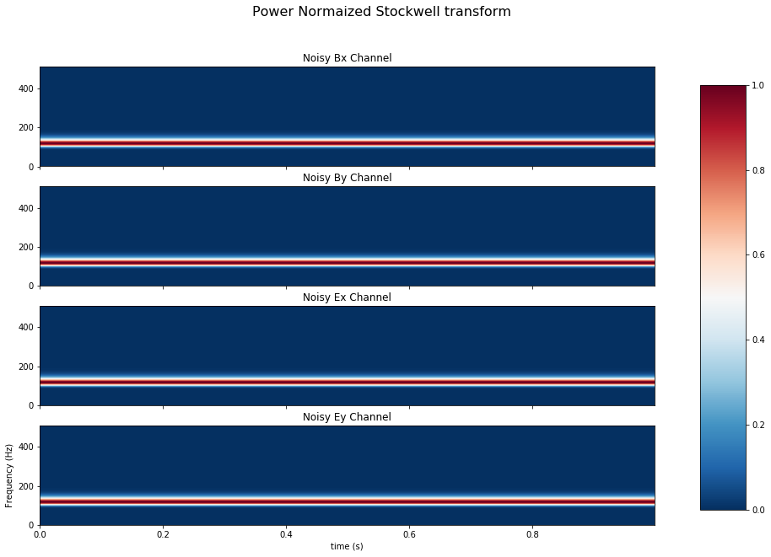
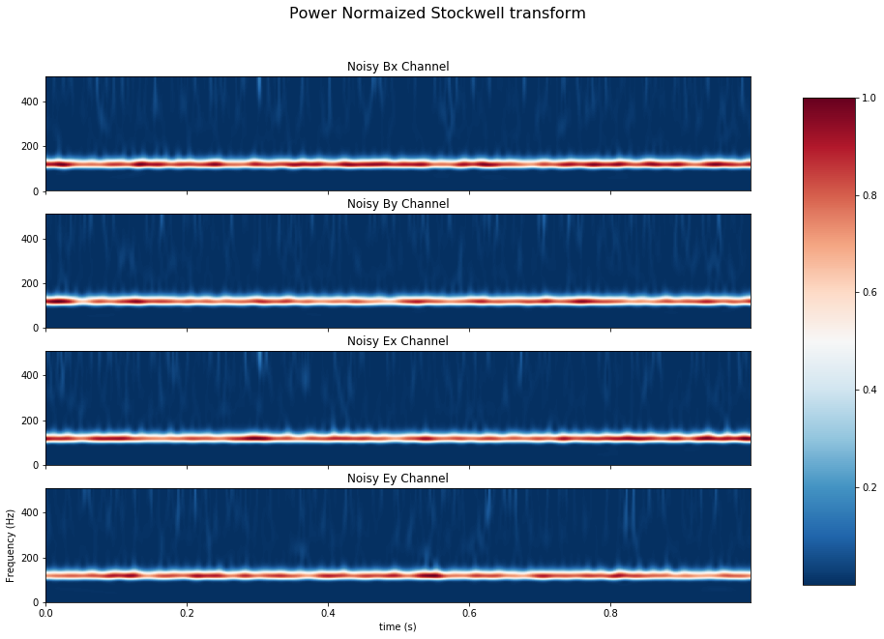
Methodology Summary
Introduction | Methodology | Results | Discussion | Conclusions
Notes:
This slides provides comparison of the S-transform of the noise free vs noisy signal.

Slide 16
Methodology Summary
Get the Data
Feature Engineering
Train the Model
Make Predictions
Validate the Model
$$B_{x}$$
𝐵_𝑥
X_Train
$$E_{y}$$
𝐸_𝑦
Y_Train
$$B_{y}$$
𝐵_𝑦
X_Val
$$E_{x}$$
𝐸_𝑥
Y_Val
Obtain the power matrices
Set Training (Bx maps to Ey) and
Validation (By to Ex) Data
Define the architecture of the model
Configure the loss function and the optimizer
Train (fit) the model
Introduction | Methodology | Results | Discussion | Conclusions
Notes:
Once obtained the power matrix from the S-transform, the procedure for training (or fitting the data) is:
Set Training (Bx maps to Ey) and Validation (By to Ex)
(this assumption can be made for a 1D or a homogenous simplification)
Define the architecture of the model (stack 3 LSTM networks)
Configure the loss function and the optimizer (MSE and rmsprop)
Train (fit) the model

Slide 17
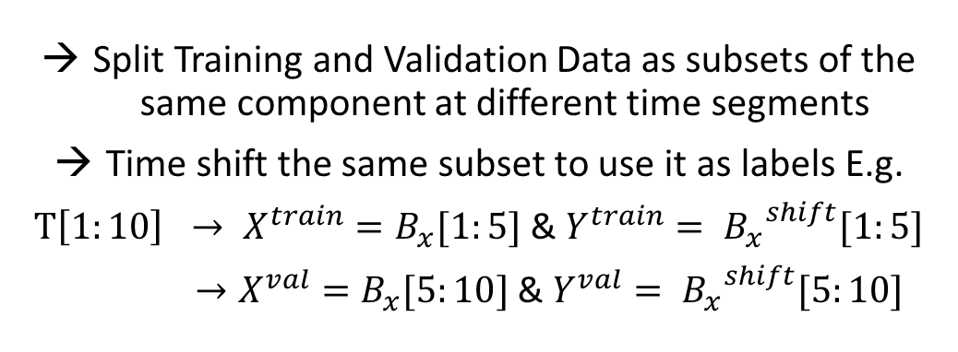
Alternative ML Model for real data
Get the Data
Feature Engineering
Train the Model
Make Predictions
Validate the Model
$$B_{x}$$
𝐵_𝑥
X_Train
Y_Train
$$B_{x}$$
𝐵_𝑥
X_Val
$${{ B}_{x}}^{s}$$
〖〖 𝐵〗_𝑥〗^𝑠
Y_Val
$${{ B}_{x}}^{s}$$
〖〖 𝐵〗_𝑥〗^𝑠
Split Training and Validation Data as subsets of the same component at different time segments
Time shift the same subset to use it as labels E.g.
$T\left[1:10\right] → X^{train}=B_{x}[1:5]$ & $Y^{train}= {B_{x}^{}}^{shift}[1:5]$
$→X^{val}=B_{x}[5:10]$ & $Y^{val}= {B_{x}^{}}^{shift}[5:10]$
Introduction | Methodology | Results | Discussion | Conclusions
Notes:
Also this works proposes an alternative model that can be used to avoid the 1D medium simplification, in witch every component is supervised with its future time steps. In other words, we can map e.g. Bx to Bx shifted.

Slide 18
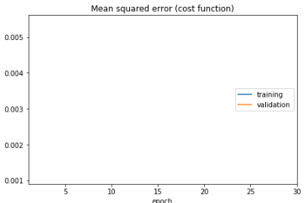
Methodology Summary
Get the Data
Feature Engineering
Train the Model
Make Predictions
Validate the Model
Introduction | Methodology | Results | Discussion | Conclusions
Notes:
To validate the model the main idea is to qualitatively and quantitatively evaluate how the subset of data that wasn't use for the training is fitted with the learned MF.
This slide shows Training subset in blue and Validation subset in orange for the MSE (loss score)

Slide 19
Methodology Summary
Get the Data
Feature Engineering
Train the Model
Make Predictions
Validate the Model
Train (fit) the model
Obtain the Mapping Function (MP)
Use the ML to predict denoised E components
Introduction | Methodology | Results | Discussion | Conclusions
Notes:
Our results are the predictions of E given B, as we mentioned earlier the mapping function discards the non coherent noise in the data, therefore what we will see in the results are the denoised electric components obtained from the MF.

Slide 20
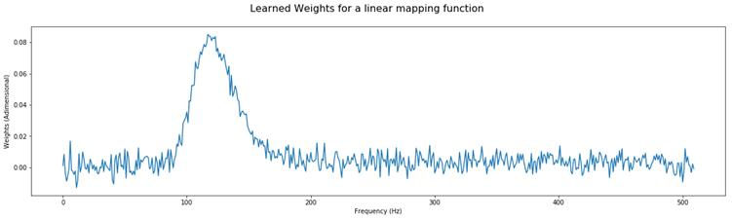
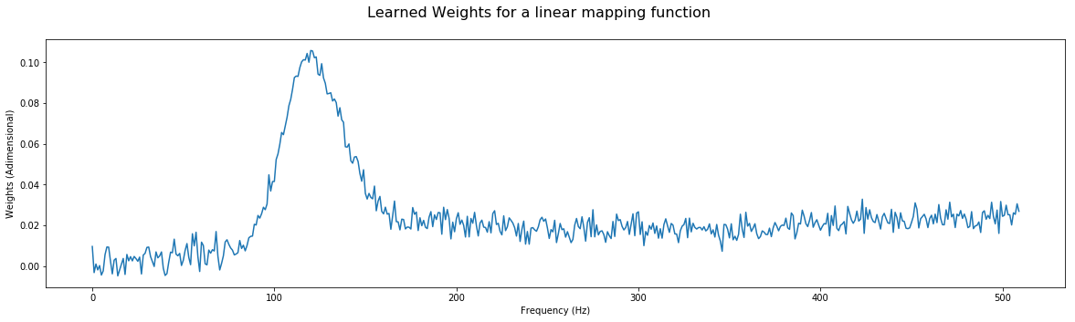
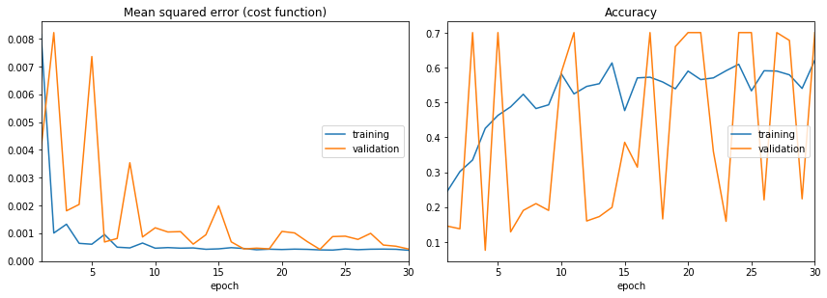
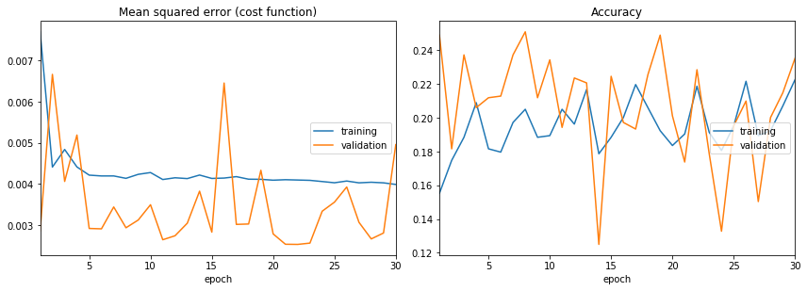
Metrics $1^{rst}$ & $2^{nd}$ Simulations
Simulation: 2
Noise Co. 1
Simulation: 1
Noise Co. 0.3
Simulation: 1
Simulation: 2
Introduction | Methodology | Results | Discussion | Conclusions
Notes:
The upper is a plot of the learned weights for the first and second simulation, weights depict the importance of the 120 Hz frequency, although the values starts to trend-up for higher frequencies in the second simulation.
Lower graphs show that although both simulations reduce training error, simulation 1 obtains an overall better misfit. (0.001 < 0.003).

Slide 21
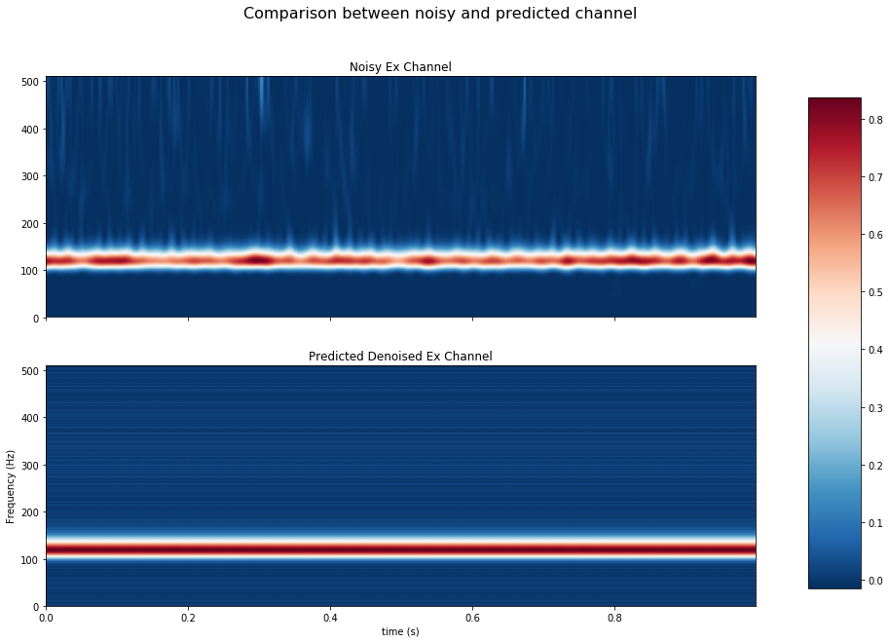
Results $1^{rst}$ Simulation
Introduction | Methodology | Results | Discussion | Conclusions
Notes:
Results $1^{rst}$ Simulation
Predicted Ex successfully enhanced the 120 Hz signal and diminished other frequencies, recall that here the noise amplitude is a third of the signal’s.

Slide 22
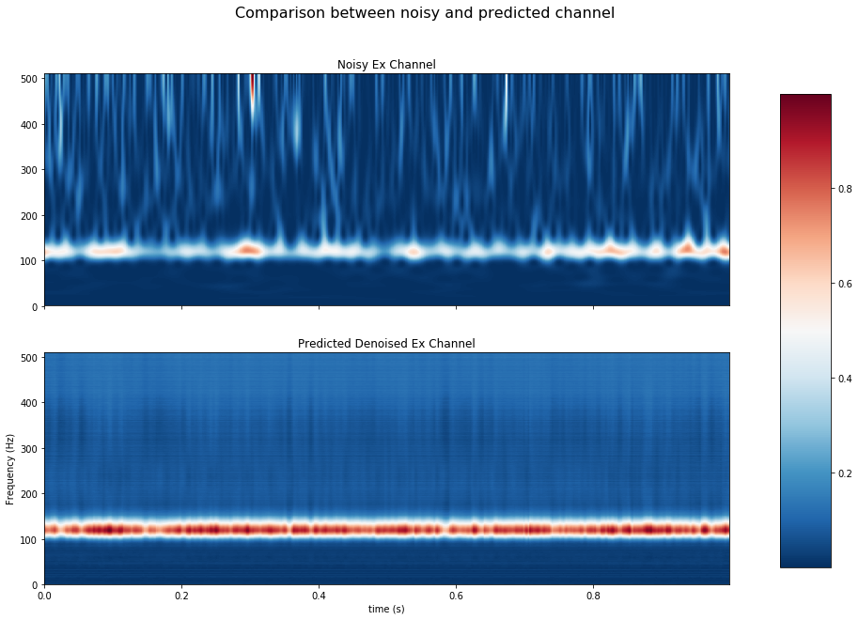
Results $2^{nd}$ Simulation
Introduction | Methodology | Results | Discussion | Conclusions
Notes:
Results $2^{nd}$ Simulation
Here the noise magnitude equals the signal’s. It can be seen that the 120 Hz is still evident although the noise in this occasion is not fully removed.
Simulations ran for higher noise values presented the same behavior, higher the noise less effective the model if the hyperparameters are not readjusted.

Slide 23
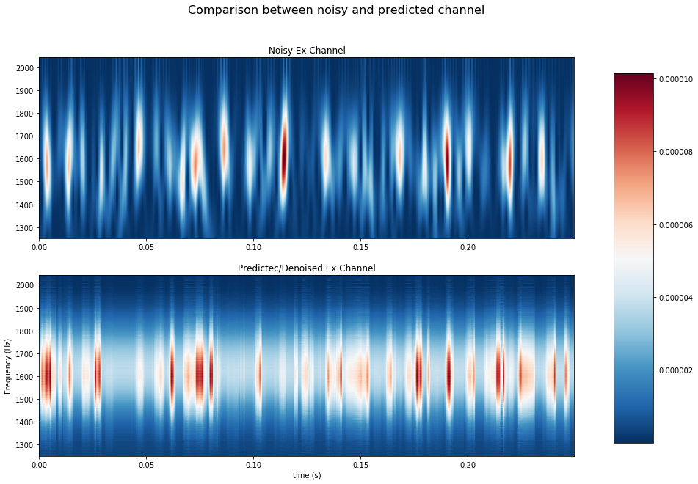
Results Real Data
Introduction | Methodology | Results | Discussion | Conclusions
Notes:
Results Real Data
Here we can see how the ML model applied for real data predicts a continuous frequency band that peaks at ~1600 Hz. Which is not evident in the noisy signal.
keep in mind that this is a small subset (1024 samples of more than 200000 total)

Slide 24
What have we seen?
Weaknesses of the method?
Is there another way to interpret results?
What further research would be necessary?
What is the contribution?
How do these results relate to the original objectives?
Do the data support the hypothesis?
The ML approach to denoise is accurate and an effective workflow is presented.
Python provides an excellent programing environment for the task.
The S-transform provides an effective tool; it success in depicting the declared fundamental frequency.
Introduction | Methodology | Results | Discussion | Conclusions
Notes:
Results suggest that the ML approach to denoise every component is accurate; it is possible to denoise every channel by systematical assigning the corresponding combination of training data to each channel. The weights obtained from the ML regression model could be further used to stablish a workflow that leads to retrieving the apparent resistivities of the strata.
As it can be inferred from the values of the validation graphs and the S-transforms plots of the denoised channel, the methodology is compromised as the noise to signal proportion increases, as it could be expected. Although readjusting the hyperparameters or/and providing more input data seems to compensate until a certain point, when the noise magnitude gets to be many times higher than the signal’s. In this work synthetic EM data was effectively denoised to a proportion of 3 times the magnitude of the noise to the signal´s. For higher magnitudes of noise other approaches can then be tested, such as improving the feature engineering, for example, finding the most appropriate length of the Gaussian window of the applied S-transform or using a non-linear frequency scale, also, evaluating different TFR. Although, as expected, the S-transform provides an effective approach; it success in depicting the declared fundamental frequency of the synthetic generated data.
It has to be kept I in mind that the models works on the assumption of the empirical physical relations of the electromagnetic field, finding a mapping function between the magnetic and electrical components. Further experimentation can be done to implement a variation of the proposed model for a 2D inversion case, using the input tensor containing the real and the imaginary components of the TFR, therefore retrieving a complex mapping function that can be related more directly to the impedance tensor.
The mapping function finds correlation for coherent noise among the channels; this influence could be further studied. Proposedly, alternative methods may be more efficient to reduce to a better margin the signal to noise ratio; architected with deeper neural network or/and more pioneering models such as convolutional LSTM networks, Bidirectional RNN and so on. In particular, to reduce coherent noise reinforcement learning and self-supervised models could provide a valuable approach.
The use of Python as proposed for the task proved to be advantageous, most of the required tools are already to be found very well optimized in native libraries. It is a huge benefit to have libraries such as TensorFlow that can be used for optimal numerical processing on a CPU (CUDA / CuDNN) and better yet a GPU (BLAS / Eigen), this should lead geo-data-science in parallel with up to date advances in machine learning. The extensibility of the notions that ML can bring to geosciences research are noted.

Slide 25
What have we seen?
Weaknesses of the method?
Is there another way to interpret results?
What further research would be necessary?
What is the contribution?
How do these results relate to the original objectives?
Do the results support the hypothesis?
Results suggest that TFR as input data provides an effective feature engineering.
S-transform provides good resolution for the input data; similar resolution is obtain from the predictions.
The relationship between EM components can be used to train effective ML models.
Introduction | Methodology | Results | Discussion | Conclusions
Notes:
Results suggest that the ML approach to denoise every component is accurate; it is possible to denoise every channel by systematical assigning the corresponding combination of training data to each channel. The weights obtained from the ML regression model could be further used to stablish a workflow that leads to retrieving the apparent resistivities of the strata.
As it can be inferred from the values of the validation graphs and the S-transforms plots of the denoised channel, the methodology is compromised as the noise to signal proportion increases, as it could be expected. Although readjusting the hyperparameters or/and providing more input data seems to compensate until a certain point, when the noise magnitude gets to be many times higher than the signal’s. In this work synthetic EM data was effectively denoised to a proportion of 3 times the magnitude of the noise to the signal´s. For higher magnitudes of noise other approaches can then be tested, such as improving the feature engineering, for example, finding the most appropriate length of the Gaussian window of the applied S-transform or using a non-linear frequency scale, also, evaluating different TFR. Although, as expected, the S-transform provides an effective approach; it success in depicting the declared fundamental frequency of the synthetic generated data.
It has to be kept I in mind that the models works on the assumption of the empirical physical relations of the electromagnetic field, finding a mapping function between the magnetic and electrical components. Further experimentation can be done to implement a variation of the proposed model for a 2D inversion case, using the input tensor containing the real and the imaginary components of the TFR, therefore retrieving a complex mapping function that can be related more directly to the impedance tensor.
The mapping function finds correlation for coherent noise among the channels; this influence could be further studied. Proposedly, alternative methods may be more efficient to reduce to a better margin the signal to noise ratio; architected with deeper neural network or/and more pioneering models such as convolutional LSTM networks, Bidirectional RNN and so on. In particular, to reduce coherent noise reinforcement learning and self-supervised models could provide a valuable approach.
The use of Python as proposed for the task proved to be advantageous, most of the required tools are already to be found very well optimized in native libraries. It is a huge benefit to have libraries such as TensorFlow that can be used for optimal numerical processing on a CPU (CUDA / CuDNN) and better yet a GPU (BLAS / Eigen), this should lead geo-data-science in parallel with up to date advances in machine learning. The extensibility of the notions that ML can bring to geosciences research are noted.

Slide 26
What have we seen?
Weaknesses of the method?
What further research would be necessary?
What is the contribution?
How do these results relate to the original objectives?
Do the data support the hypothesis?
The models works on the assumption E=ZB.
As noise increases; readjusting the hyperparameters is needed to compensate.
The presented case is valid for a 1D medium.
Is there another way to interpret results?
Processing power delimits the amount of data and the speed of the method CPU<GPU<TPU
Introduction | Methodology | Results | Discussion | Conclusions
Notes:
Results suggest that the ML approach to denoise every component is accurate; it is possible to denoise every channel by systematical assigning the corresponding combination of training data to each channel. The weights obtained from the ML regression model could be further used to stablish a workflow that leads to retrieving the apparent resistivities of the strata.
As it can be inferred from the values of the validation graphs and the S-transforms plots of the denoised channel, the methodology is compromised as the noise to signal proportion increases, as it could be expected. Although readjusting the hyperparameters or/and providing more input data seems to compensate until a certain point, when the noise magnitude gets to be many times higher than the signal’s. In this work synthetic EM data was effectively denoised to a proportion of 3 times the magnitude of the noise to the signal´s. For higher magnitudes of noise other approaches can then be tested, such as improving the feature engineering, for example, finding the most appropriate length of the Gaussian window of the applied S-transform or using a non-linear frequency scale, also, evaluating different TFR. Although, as expected, the S-transform provides an effective approach; it success in depicting the declared fundamental frequency of the synthetic generated data.
It has to be kept I in mind that the models works on the assumption of the empirical physical relations of the electromagnetic field, finding a mapping function between the magnetic and electrical components. Further experimentation can be done to implement a variation of the proposed model for a 2D inversion case, using the input tensor containing the real and the imaginary components of the TFR, therefore retrieving a complex mapping function that can be related more directly to the impedance tensor.
The mapping function finds correlation for coherent noise among the channels; this influence could be further studied. Proposedly, alternative methods may be more efficient to reduce to a better margin the signal to noise ratio; architected with deeper neural network or/and more pioneering models such as convolutional LSTM networks, Bidirectional RNN and so on. In particular, to reduce coherent noise reinforcement learning and self-supervised models could provide a valuable approach.
The use of Python as proposed for the task proved to be advantageous, most of the required tools are already to be found very well optimized in native libraries. It is a huge benefit to have libraries such as TensorFlow that can be used for optimal numerical processing on a CPU (CUDA / CuDNN) and better yet a GPU (BLAS / Eigen), this should lead geo-data-science in parallel with up to date advances in machine learning. The extensibility of the notions that ML can bring to geosciences research are noted.

Slide 27
What have we seen?
Weaknesses of the method?
Is there another way to interpret results?
What further research would be necessary?
What is the contribution?
How do these results relate to the original objectives?
Do the data support the hypothesis?
The method can be regarded as a way to determine the impedance tensor Z (Mapping Function) and with it denoise the data.
Introduction | Methodology | Results | Discussion | Conclusions
Notes:
Results suggest that the ML approach to denoise every component is accurate; it is possible to denoise every channel by systematical assigning the corresponding combination of training data to each channel. The weights obtained from the ML regression model could be further used to stablish a workflow that leads to retrieving the apparent resistivities of the strata.
As it can be inferred from the values of the validation graphs and the S-transforms plots of the denoised channel, the methodology is compromised as the noise to signal proportion increases, as it could be expected. Although readjusting the hyperparameters or/and providing more input data seems to compensate until a certain point, when the noise magnitude gets to be many times higher than the signal’s. In this work synthetic EM data was effectively denoised to a proportion of 3 times the magnitude of the noise to the signal´s. For higher magnitudes of noise other approaches can then be tested, such as improving the feature engineering, for example, finding the most appropriate length of the Gaussian window of the applied S-transform or using a non-linear frequency scale, also, evaluating different TFR. Although, as expected, the S-transform provides an effective approach; it success in depicting the declared fundamental frequency of the synthetic generated data.
It has to be kept I in mind that the models works on the assumption of the empirical physical relations of the electromagnetic field, finding a mapping function between the magnetic and electrical components. Further experimentation can be done to implement a variation of the proposed model for a 2D inversion case, using the input tensor containing the real and the imaginary components of the TFR, therefore retrieving a complex mapping function that can be related more directly to the impedance tensor.
The mapping function finds correlation for coherent noise among the channels; this influence could be further studied. Proposedly, alternative methods may be more efficient to reduce to a better margin the signal to noise ratio; architected with deeper neural network or/and more pioneering models such as convolutional LSTM networks, Bidirectional RNN and so on. In particular, to reduce coherent noise reinforcement learning and self-supervised models could provide a valuable approach.
The use of Python as proposed for the task proved to be advantageous, most of the required tools are already to be found very well optimized in native libraries. It is a huge benefit to have libraries such as TensorFlow that can be used for optimal numerical processing on a CPU (CUDA / CuDNN) and better yet a GPU (BLAS / Eigen), this should lead geo-data-science in parallel with up to date advances in machine learning. The extensibility of the notions that ML can bring to geosciences research are noted.

Slide 28
What have we seen?
Weaknesses of the method?
Is there another way to interpret results?
What further research would be necessary?
How do these results relate to the original objectives?
Do the data support the hypothesis?
To implement the model on 2D medium, complex tensors should be input. In this way the MF could be used to deduce the apparent resistivities .
What is the contribution?
Further assessment on real data to provide more validation.
Introduction | Methodology | Results | Discussion | Conclusions
Notes:
Results suggest that the ML approach to denoise every component is accurate; it is possible to denoise every channel by systematical assigning the corresponding combination of training data to each channel. The weights obtained from the ML regression model could be further used to stablish a workflow that leads to retrieving the apparent resistivities of the strata.
As it can be inferred from the values of the validation graphs and the S-transforms plots of the denoised channel, the methodology is compromised as the noise to signal proportion increases, as it could be expected. Although readjusting the hyperparameters or/and providing more input data seems to compensate until a certain point, when the noise magnitude gets to be many times higher than the signal’s. In this work synthetic EM data was effectively denoised to a proportion of 3 times the magnitude of the noise to the signal´s. For higher magnitudes of noise other approaches can then be tested, such as improving the feature engineering, for example, finding the most appropriate length of the Gaussian window of the applied S-transform or using a non-linear frequency scale, also, evaluating different TFR. Although, as expected, the S-transform provides an effective approach; it success in depicting the declared fundamental frequency of the synthetic generated data.
It has to be kept I in mind that the models works on the assumption of the empirical physical relations of the electromagnetic field, finding a mapping function between the magnetic and electrical components. Further experimentation can be done to implement a variation of the proposed model for a 2D inversion case, using the input tensor containing the real and the imaginary components of the TFR, therefore retrieving a complex mapping function that can be related more directly to the impedance tensor.
The mapping function finds correlation for coherent noise among the channels; this influence could be further studied. Proposedly, alternative methods may be more efficient to reduce to a better margin the signal to noise ratio; architected with deeper neural network or/and more pioneering models such as convolutional LSTM networks, Bidirectional RNN and so on. In particular, to reduce coherent noise reinforcement learning and self-supervised models could provide a valuable approach.
The use of Python as proposed for the task proved to be advantageous, most of the required tools are already to be found very well optimized in native libraries. It is a huge benefit to have libraries such as TensorFlow that can be used for optimal numerical processing on a CPU (CUDA / CuDNN) and better yet a GPU (BLAS / Eigen), this should lead geo-data-science in parallel with up to date advances in machine learning. The extensibility of the notions that ML can bring to geosciences research are noted.

Slide 29
What have we seen?
Weaknesses of the method?
Is there another way to interpret results?
What further research would be necessary?
What is the contribution?
How do these results relate to the original objectives?
Do the data support the hypothesis?
The main contribution is the establishment of an open sourced code that can be used to denoise EM time series
Introduction | Methodology | Results | Discussion | Conclusions
Notes:
Results suggest that the ML approach to denoise every component is accurate; it is possible to denoise every channel by systematical assigning the corresponding combination of training data to each channel. The weights obtained from the ML regression model could be further used to stablish a workflow that leads to retrieving the apparent resistivities of the strata.
As it can be inferred from the values of the validation graphs and the S-transforms plots of the denoised channel, the methodology is compromised as the noise to signal proportion increases, as it could be expected. Although readjusting the hyperparameters or/and providing more input data seems to compensate until a certain point, when the noise magnitude gets to be many times higher than the signal’s. In this work synthetic EM data was effectively denoised to a proportion of 3 times the magnitude of the noise to the signal´s. For higher magnitudes of noise other approaches can then be tested, such as improving the feature engineering, for example, finding the most appropriate length of the Gaussian window of the applied S-transform or using a non-linear frequency scale, also, evaluating different TFR. Although, as expected, the S-transform provides an effective approach; it success in depicting the declared fundamental frequency of the synthetic generated data.
It has to be kept I in mind that the models works on the assumption of the empirical physical relations of the electromagnetic field, finding a mapping function between the magnetic and electrical components. Further experimentation can be done to implement a variation of the proposed model for a 2D inversion case, using the input tensor containing the real and the imaginary components of the TFR, therefore retrieving a complex mapping function that can be related more directly to the impedance tensor.
The mapping function finds correlation for coherent noise among the channels; this influence could be further studied. Proposedly, alternative methods may be more efficient to reduce to a better margin the signal to noise ratio; architected with deeper neural network or/and more pioneering models such as convolutional LSTM networks, Bidirectional RNN and so on. In particular, to reduce coherent noise reinforcement learning and self-supervised models could provide a valuable approach.
The use of Python as proposed for the task proved to be advantageous, most of the required tools are already to be found very well optimized in native libraries. It is a huge benefit to have libraries such as TensorFlow that can be used for optimal numerical processing on a CPU (CUDA / CuDNN) and better yet a GPU (BLAS / Eigen), this should lead geo-data-science in parallel with up to date advances in machine learning. The extensibility of the notions that ML can bring to geosciences research are noted.

Slide 30
What have we seen?
Future experimentation is wide open to hyperparameter adjustment and feature engineering.
More elaborate model architectures can be design to directly find the medium resistivity values.
EM methods benefits from effective denoising and in turn provide better results for reservoir characterization.
The presented workflow efficiently enhances the signal to noise ratio.
Introduction | Methodology | Results | Discussion | Conclusions
Notes:
You should provide a clear scientific justification for your work in this section,
and indicate uses and extensions if appropriate.
Moreover, you can suggest future experiments and point out those that are underway.
You can propose present global and specific conclusions, in relation to the objectives included in the introduction.
A successful methodology was established to improve the signal to noise ration of the Electromagnetic component with Machine Learning, specifically with Long Short-Term Memory Networks (LSTM). The methodology tested in real data provides a clearer representation of the signal.
In this methodology is important to use a time frequency representation as an input tensor for the Machine Learning model. This enables the use of the physical relations between the electromagnetic fields which is in the frequency domain B=Z*E. The implementation of the S- Transform is convenient because it is an open source code in the python module MNE and it has been proved that provides a quality time frequency representation of the generated synthetic data.
The application of the LSTM successfully achieved an effective representation of the fundamental frequency declared for the synthetic generated signal (120 Hz) taking as an input the signal with the induced Gaussian noise (up to three times the magnitude of the noise vs the magnitude of the signal). Therefore the LSTM Network model has been proved a feasible method to enhance the signal to noise ratio.
Modified versions of the proposed workflow can be further applied in similar time-series analysis problems. Mainly, in controlled sourced electromagnetic methods which depend upon similar physical relations as the one studied in this work.
The proposed methodology was implemented on a regular Central Processing Unit (CPU).It could be many times more computing cost-effective if it would be implemented on a Graphic Processing Unit (GPU) or even better in a Tensor Processing Units (TPU).
This work validates the capacity of Machine Learning to improve the achievements of data analysis in geoscience.

Slide 31
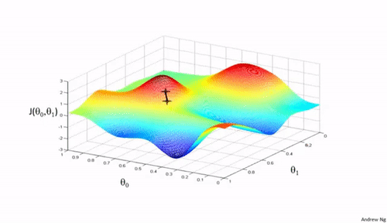
Thanks for the attention
“Being able to go from idea to result with the least possible delay is key to doing good research.” Keras

